Slide 1
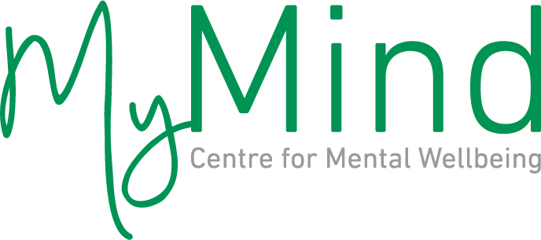
MyMind In Action
Gráinne O’Rourke, Head of Communications
April 28 2021

Slide 2
Welcome to
MyMind
MyMind was set up in 2006 in response to the clear gap in mental health services in Ireland.
MyMind is a social enterprise, a not-for-profit charity, a Business for impact.

Slide 3
What Makes MyMind Different
Affordable and Accessible
Direct Access
You can book your appointment online or give us a call.
Fast
Your first appointment is usually within 72 hours or even the same day.
Multidisciplinary
A diverse team of mental health professionals who use many different approaches to counselling and psychotherapy.
Multilingual
Appointments are available in many different languages.
Affordable
We offer high quality service at affordable rates.

Slide 4
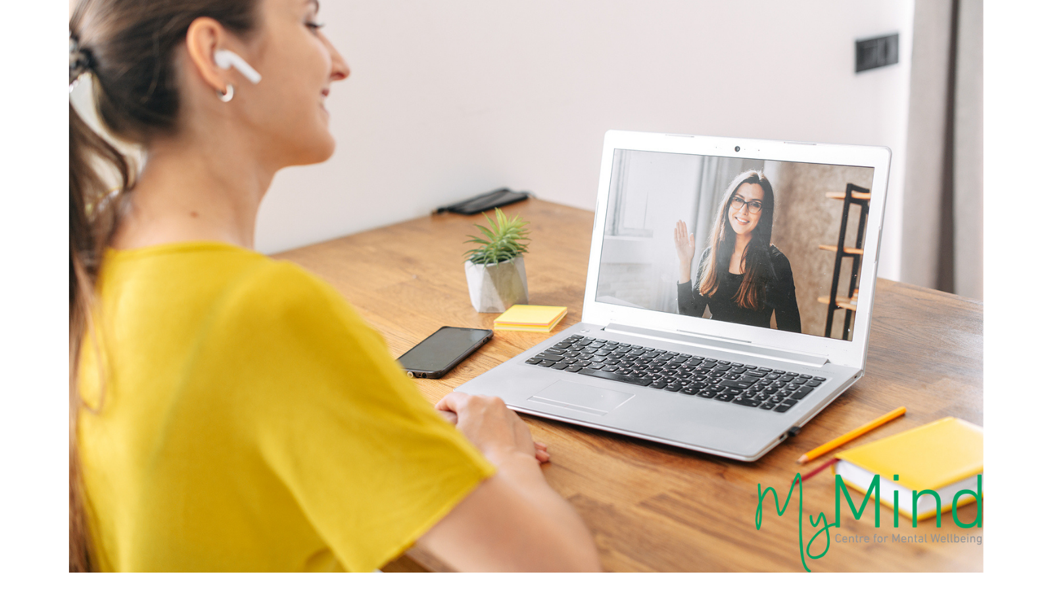
MyMind’s technology platform
MyMind has its own integrated technology platform.
Offers confidentiality, ease of access and is safe and secure.

Slide 5
MyMind services at a glance
Range of services
One-to-one counselling and psychotherapy and personal development coaching face to face and online
Couples counselling
and psychotherapy,
pre-marriage course
Children and adolescent psychotherapy
Family counselling
Workshops on mental health and wellbeing

Slide 6

MyMind services at a glance
Range of services

Slide 7
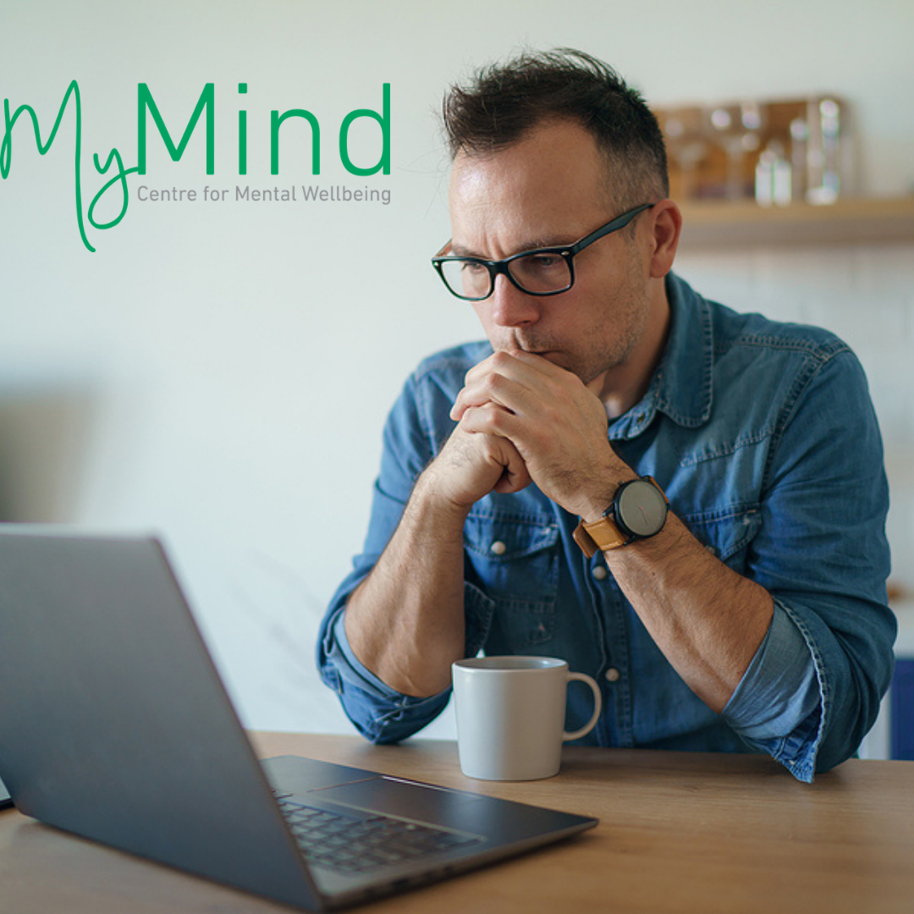
Covid-19 Project
Free online counselling appointments since June 2020
This project has received funding from Sláintecare and the HSE Community Operations Mental Health

Slide 8
Get in Touch
With Us
Centres
Dublin 1: 7A Store St, Dublin 1
Dublin 6: 137 Lower Rathmines Road, Rathmines, Dublin 6
Dublin 8: 2A Christchurch Hall, High Street, Dublin 8
Cork: 6 South Bank, Crosse’s Green, Cork.
Limerick: 50 O’Connell St, Limerick.
Get in touch
For more information:
visit mymind.org
email hq@mymind.org or call 076 680 10 60
to book an appointment, visit: app.mymind.org
Mymind.org

