Slide 1


Supporting people and communities in crisis

Slide 2

INTRODUCTION TO PIETA
Pieta is a charity, founded in 2006 by Joan Freeman with our first centre in Lucan.
We provide free, professional therapy and a Freephone 24/7 crisis helpline to those engaging in self-harm, with suicidal ideation or bereaved by suicide.
We have one common goal where no-one should feel so alone or so afraid that suicidal ideation or self-harming becomes an option they choose.

Slide 3
IMPACT
Since we opened our doors we have supported over 65,000 people through the delivery of our prevention, intervention and postvention services.
Last year alone our Freephone 24/7 crisis helpline team have answered over 77,000 calls and texts, double the amount from 2019.
But we can’t continue to do this without the financial support of corporate partners, community groups, Darkness into Light Committees and participants.
We receive approximately 20% of our funds from government and need your support, every year, to continue to help people in suicidal crisis from a place of darkness to a place of hope

Slide 4

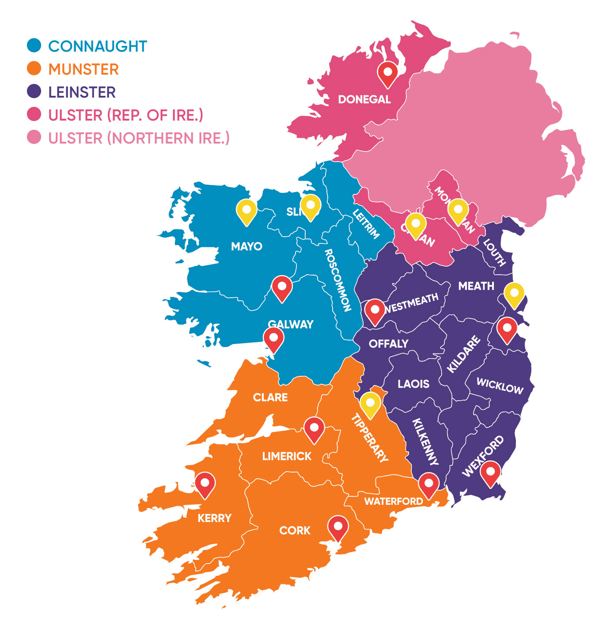
EXPANSION: 15 YEARS > 20 LOCATIONS
2006 Lucan
2008 Santry, Tallaght
2010 Limerick
2011 Ballyfermot
2013 Roscrea, Tuam & Cork
2014 Kerry
2016 Waterford & Wexford
2017 Donegal, Collins Avenue & Athlone
2018 Galway, Ballina & Sligo
2019 Skerries, North Co. Dublin
2020 Cavan & Monaghan

Slide 5
Prevention > FREEPHONE, 24/7 CRISIS HELPLINE
24 Hours 7 Days per week all year round
Operated by Qualified Therapists.
Support & information regarding services.
Text line that is available to everyone.
Text HELP to 51444
1800 247 247
24
/
7

Slide 6
Clinical Services

Slide 7

INTERVENTION > PIETA THERAPY
THE PIETA WAY
This is our strengths based and solution focussed model providing up to 12 sessions of free counselling. We help clients who are struggling with self-harm and suicidal thoughts to find hope through new perspectives and coping skills.
THERAPIES
All our therapists are professionally qualified, accredited and chosen for their personal warmth. Therapists are trained in the Pieta Way therapeutic model.
USER FRIENDLY
No GP referral required – clients can access our services directly.
Our service is designed to be warm, welcoming and friendly.
No financial barrier – all Pieta services are delivered free to our clients.

Slide 9


SUICIDE

Slide 10


KNOW SUICIDE. KNOW THE SIGNS

Slide 11

SUICIDE – WARNING SIGNS – CONTACT PIETA
Emotional Outbursts – Crying/Anger
Increased use of Alcohol/Drugs
Talking of plans or methods
Talking about feelings of hopelessness
Loss of interest in things they once loved
Withdrawing / Isolating
Threats/Statements (eg, “I have no future”, “no light at the end of the tunnel”)
Giving away possessions
Reckless Behaviour – Risk taking
Low Mood – Depression
Change in sleep patterns

Slide 12
SUICIDE > MYTHS & FACTS
MYTH
People who talk about suicide will never complete it.
MYTH
Only clinically depressed people struggle with thoughts of suicide.
MYTH
Talking about suicide encourages it.
FACT
80% of people who complete suicide have told someone how they felt in the months before hand.
FACT
A lot of people who die by suicide have no history of depression – they are reacting to life events.
FACT
Talking about suicide can save a life by encouraging someone to seek help.

Slide 13
HOW CAN I HELP? APR
ASK
If the person is opening up to you, engage them in a non-judgemental manner with empathy.
Don’t be afraid to ask them directly if they are struggling with thoughts of suicide or self-harm.
PERSUADE
Calmly and gently encourage the person to seek help.
Offer to make a call or to bring them to an appointment if possible.
Give them the Pieta helpline number.
REFER
As quickly as you can, refer or guide the person you are concerned about to Pieta (or your doctor or local mental health service).
If you can, make the call or travel with them to the appointment.

Slide 14

A MESSAGE OF HOPE
It’s OK not to be OK – We all struggle in life from time to time but with the right support you can get through it.
It’s our instinct to survive.
Remember : Support is just a call or text away and you too can make the difference by helping others to get help when they need it.

Slide 15
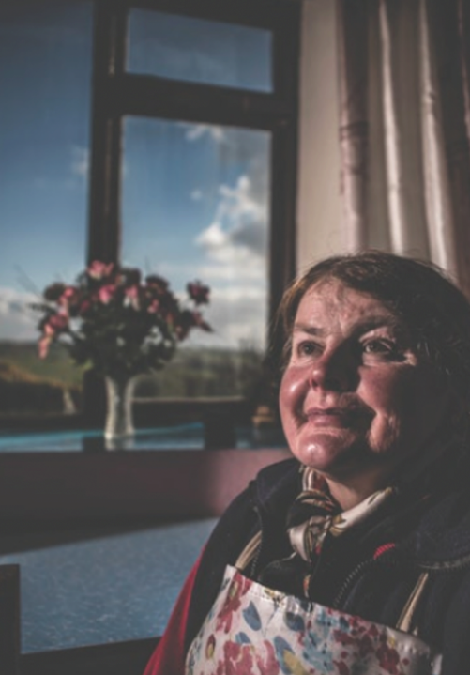
Thank you for listening

